Slide 1
05 | Integrating and Extending Cloud Services
Bret Stateham | Sr. Technical Evangelist
Christopher Harrison | Content Developer

Slide 2
Overview
Integrating the Cloud with On-Premises Resources
Extending Cloud Services
Summary

Slide 3
Integrating the Cloud and on Premises

Slide 4



Hybrid Connections
Corporate Network
Microsoft SQL Server
Web Sites
Hybrid Connection Manager
Other published resources
Hybrid Connection
Mobile Services
Notes:
Hybrid Connections provides an easy and convenient way to connect Azure Websites and Azure Mobile Services to on-premises resources. They are a feature of Azure BizTalk Services. Benefits include:
Connect to any on-premises resource that uses a static TCP port (SQL Server, MySQL, Web APIs, and most Web Services)
Can be used with all frameworks supported by Azure Websites (.NET, PHP, Java, Python, Node.js) and Mobile Services (.NET, Node.js)
Multiple Websites or Mobile Services can share these connections
Applications using these connections can only access the specific on-premises resource being published

Slide 5
Hybrid Connections

Slide 6



Windows Azure Service Bus
EASILY CONNECT APPLICATIONS
Queues for messaging occasionally connected devices like mobile phones
Topics & Subscriptions for publishing notifications to multiple subscribers
CONNECT APPLICATIONS FROM ANYWHERE
Connect applications across:
Public cloud
Public & private cloud
Private to private cloud through public cloud
Relay to securely call private cloud applications hosted behind firewalls and NATs
Clients can run on PCs, mobile devices or browser
Use various languages (.NET, WCF, REST, Java, Node.js, PHP)
ENTERPRISE GRADE CLOUD SERVICE
99.9% monthly SLA
Delivery assurance, reliable messaging, scale and load balancing
Claims based security and identity federation with Active Directory and web identities
No need for IT to change network config or install gateway devices
Notes:
Different situations call for different styles of communication. Sometimes, letting applications send and receive messages through a simple queue is the best solution. In other situations, an ordinary queue isn't enough; a queue with a publish-and-subscribe mechanism is better. And in some cases, all that's really needed is a connection between applications-queues aren't required. Service Bus provides all three options, letting your applications interact in several different ways.

Slide 7
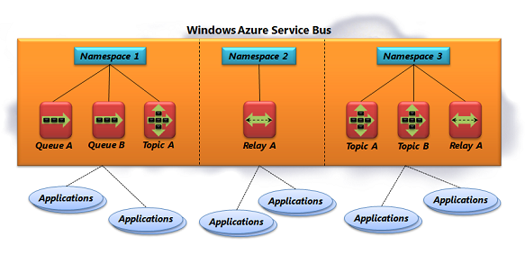
Windows Azure Service Bus
Notes:
Service Bus is a multi-tenant cloud service, which means that the service is shared by multiple users. Each user, such as an application developer, creates a namespace, then defines the communication mechanisms she needs within that namespace.
The choices are:
Queues, which allow one-directional communication. Each queue acts as an intermediary (sometimes called a broker) that stores sent messages until they are received.
Topics, which provide one-directional communication using subscriptions. Like a queue, a topic acts as a broker, but it allows each subscription to see only messages that match specific criteria.
Relays, which provide bi-directional communication. Unlike queues and topics, a relay doesn't store in-flight messages-it's not a broker. Instead, it just passes them on to the destination application.

Slide 8
Service Bus Relay

Slide 9
Extending Cloud Services

Slide 10
Web API
Framework for RESTful HTTP services
JSON support simplifies access from any client
Great tool support from Visual Studio
Notes:
ASP.NET Web API is a framework that makes it easy to build HTTP services that reach a broad range of clients, including browsers and mobile devices. ASP.NET Web API is an ideal platform for building RESTful applications on the .NET Framework.

Slide 11
Web API

Slide 12
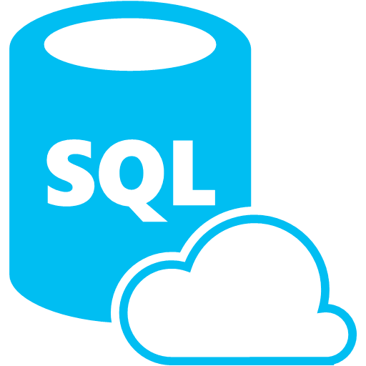


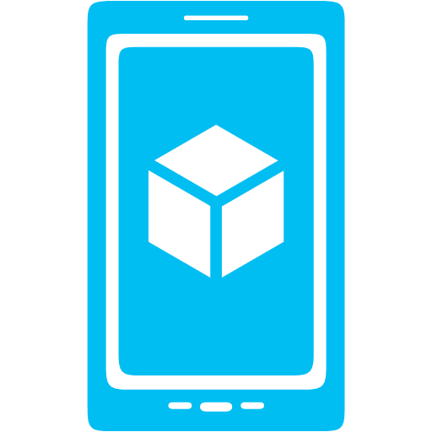



What is Mobile Services?
Storage
Authentication
Logic
Push
Scheduler
Notes:
Azure Mobile Services is a Backend-as-a-Service
Instead of you having to design, build, test, deploy, manage, and upgrade your whole backend, we do it for you
Features of Mobile Services
Storage – SQL DB
Authentication – built in support for social providers w/ ability to custom auth
Backend logic – data validation, logical flows, etc
Push Notifications – across all major mobile platforms
Scheduler – backend job processing

Slide 13
.NET Backend
Web API based w/ additional functionality, developed in and deployed from Visual Studio
TableController data context can map to SQL, Table Storage, Mongo, etc
Pull in NuGet modules and other .NET libraries
Set permissions with attributes on classes
Local Debug
Notes:
Bases off of Web API
Develop and deploy in VS (also create new Mobile Services with VS project template)
Debug locally
Can pull in NuGet and other .NET libs
TableController is base for accessing data, can be overridden to talk to Table Storage, Mongo, etc
Permissions handled as attributes on classes

Slide 14
Notification Hubs
Separate from Mobile Services
Can be used regardless of whether you’re storing data in Azure
Extremely scalable push notifications
Cross platform support
Push to iOS, Android, Kindle, Windows Phone, Windows Store
Tags (i.e. tie my registration to this topic or user ID)
Templates (i.e. when I get a push, send it in this format)
Server SDKs for .NET, Java, and Node (also open as REST API)
Notes:
Notification Hubs are a separate service from Mobile Services but also used by Mobile Services
Pushes to iOS, Android, Kindle, Windows Phone, Windows Store
Extremely scalable (millions of pushes in minutes)
Tags and templates
Server SDKs: .NET, Java (beta), Node, REST API

Slide 15
Scheduled Jobs
Executes a script on defined schedule
Can be run on demand
Ideal for any backend data processing job
Length / frequency based of Mobile Service tier
Notes:
Schedule jobs (scripts) can be run by the scheduler
Ideal for any backend job processing (regular push notification, remove old data, etc)
Length and how often you can run job based off tier of your mobile service

Slide 16
Summary

Slide 17
Review
Overview
Moving data to the cloud
Moving services to the cloud
Securing cloud services
Integrating and Extending Cloud Services

